Slide 1
Employee Data Analysis using Excel
STUDENT NAME: SHANMUGAM B
REGISTER NO: 22CCA045(asunm123312202238)
DEPARTMENT: BCOM(COMPUTER APPLICATIONS)
COLLEGE: MOHAMED SATHAK COLLEGE OF ARTS AND SCIENCE

Slide 2
PROJECT TITLE
Employee Performance Analysis using Excel

Slide 3


AGENDA
Problem Statement
Project Overview
End Users
Our Solution and Proposition
Dataset Description
Modelling Approach
Results and Discussion
Conclusion
3/21/2024 Annual Review

Slide 4

PROBLEM STATEMENT
Data Collection: Gathering relevant information such as performance metrics, attendance records, feedback surveys, and demographic details.
Data Cleaning and Preparation: Ensuring data accuracy and consistency by removing errors, duplicates, and irrelevant information.

Slide 5
Data Analysis: Using statistical methods, visualization tools, and analytical techniques to uncover patterns, trends, correlations, and anomalies within the data.
Interpretation and Insight Generation: Drawing conclusions and actionable insights from the analyzed data to support decision-making, improve HR practices, and optimize workforce management strategies.

Slide 6

PROJECT OVERVIEW
Collect and integrate employee data from various sources (e.g., HR systems, surveys, performance reviews)
Clean, transform, and prepare data for analysis- Develop Excel dashboards and reports to visualize key metrics, including: - Demographics (age, tenure, department, etc.) - Performance ratings and trends

Slide 7

WHO ARE THE END USERS?
Informed Decision-Making:
Provides managers and executives with data-driven insights to make strategic decisions about promotions, resource allocation, and organizational improvements.
2. Targeted Training and Development:
Identifies specific skill gaps and areas for improvement, allowing HR and training teams to create effective, targeted training programs.

Slide 8
3. Enhanced Employee Engagement:
Offers employees clear feedback on their performance, which boosts motivation, engagement, and alignment with the organization’s goals.
4. Optimized Compensation and Rewards:
Ensures that compensation strategies are fair and performance-based, helping to retain high performers and motivate the workforce.

Slide 9
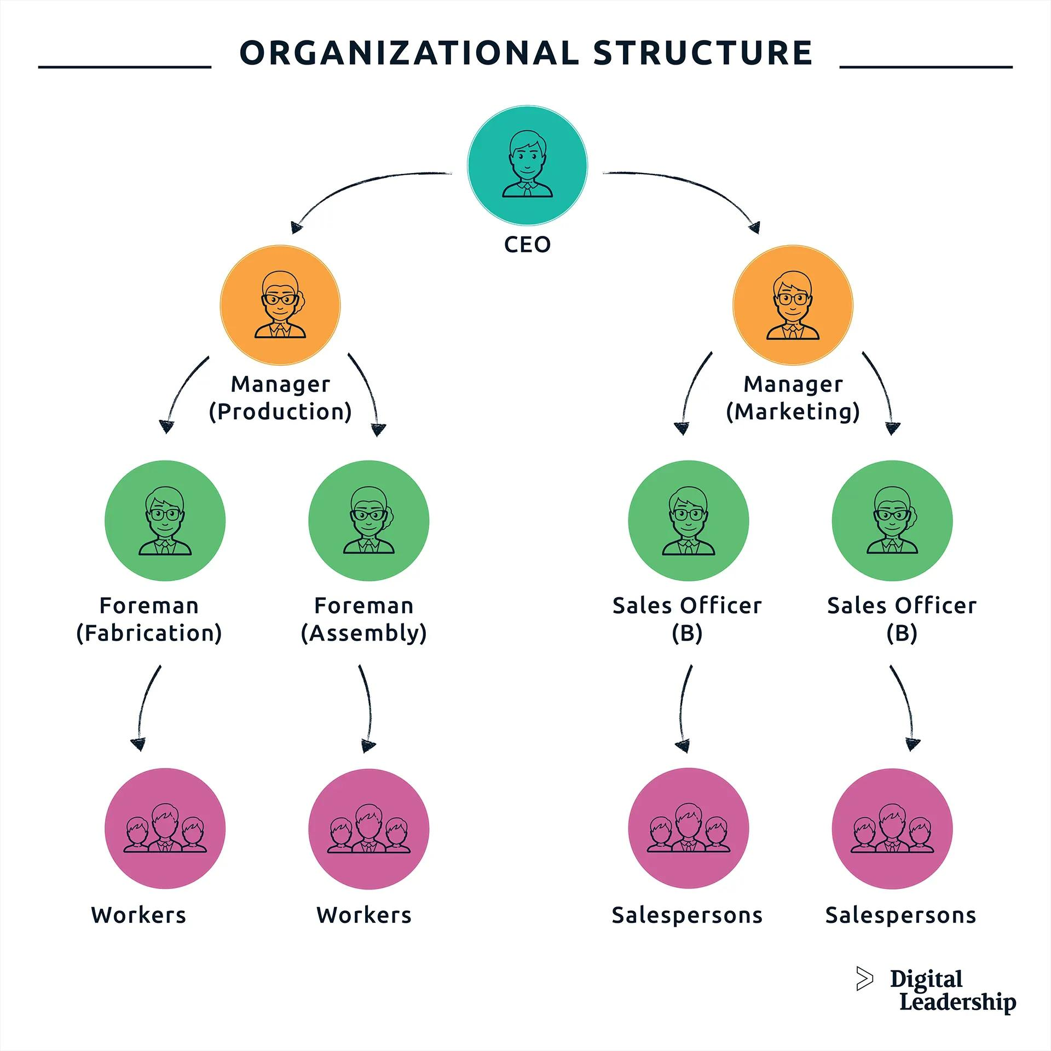

Slide 10
Dataset Description
Employee ID (unique identifier)
Name( First name ,last name)
Department
Job Title
5. Hire Date
6. Performance Ratings (e.g., 1-5 scale, low to very high)
7. Gender

Slide 11

THE "WOW" IN OUR SOLUTION
Performance analysis formula
=IFS(G5>=5,"VERY HIGH",G5>=4,"HEIGH",G5>=3,"MED",TRUE,"LOW")
3/21/2024 Annual Review
11

Slide 12
MODELLING
Data collection *
Step 1: Define the Problem and Objectives- Identify the goals of the analysis (e.g., employee turnover, performance, engagement)- Determine the key questions to answer
Step 2: Choose a Dataset- Search for relevant employee datasets on Kaggle (e.g., HR Analytics, Employee Attrition)- Select a dataset that aligns with your objectives
12

Slide 13
Step 3: Import and Explore the Data- Import the dataset into a Kaggle notebook or Excel- Explore the data using summary statistics, visualizations, and data profiling
Feature collection
- HR systems (e.g., Workday, BambooHR)- Performance management tools (e.g., Lattice, 15Five)- Employee engagement surveys (e.g., Culture Amp, SurveyMonkey)- Time-off and attendance systems (e.g., ADP, Namely)- Training and development platforms (e.g., Udemy, LinkedIn Learning)

Slide 14
Data cleaning
Remove irrelevant data
Eliminate columns or rows unrelated to performance analysis.
Handle missing values
Decide on a strategy for missing performance ratings, feedback, or other relevant data.

Slide 15
Performance level
Step 1: Prepare Your Data Collect and import relevant data, such as employee performance ratings, goals, and feedback Ensure data is organized and formatted consistently
Step 2: Categorize Performance Levels- Define performance levels (e.g., Excellent, Meets Expectations, Needs Improvement)- Assign numerical values or codes to each level

Slide 16
Step 3: Calculate Performance Scores- Use formulas to calculate performance scores based on ratings, goals, and feedback- Consider using weighted averages or indexes to combine multiple metrics
Step 4: Identify High and Low Performers- Set thresholds for high and low performers based on performance scores- Use conditional formatting or filtering to highlight high and low performers

Slide 17
Pivot summary
1. Data Aggregation: Summarize data by sum, average, count, or other functions.
2. Data Rotation: Rotate data to view different perspectives (e.g., switch rows and columns).
3. Customization: Create personalized summaries by selecting specific fields and filters.
4. Drill-Down Capability: Double-click to view detailed data behind summary values.

Slide 18
RESULTS
18

Slide 19
conclusion
- "Data analysis is not just about numbers, it's about telling a story that drives action and improves employee lives."

